Slide 1
Semantic Segmentation of Urban Streets
Team Members:
Trisha Baldha (18BCP118)
Malvi Mungalpara (18BCP059)
Yanvi Soni (18BCP130)
Priyanka Goradia (18BCP137)

Slide 2
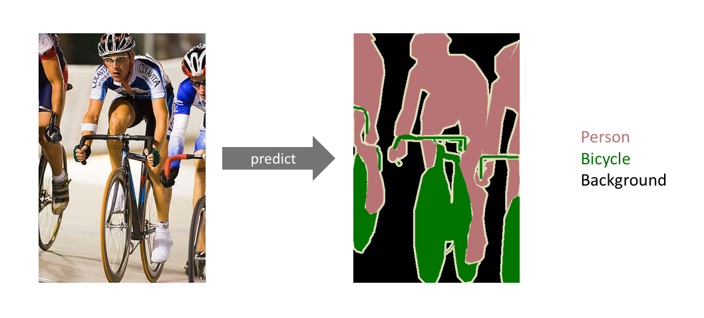
Semantic Segmentation
Label each pixel of an image with a corresponding class of what is being represented
Referred to as dense prediction.
We only care about the category of each pixel.
Fine-grained inference by making dense predictions inferring labels for every pixel, so that each pixel is labeled with the class of its enclosing object or region.

Slide 3
Problem Statement Definition
Most actively researched areas is self-driving in the automotive industry.
Components like lidars, cameras, sensors and the algorithms running behind them, must work closely together to achieve fully autonomous driving.
Complex systems are based on several camera-based components that are required for a fully autonomous vehicle. These components cover many aspects, of which the semantic segmentation is a core element.
safe integration of self driving cars on existing roads with necessary perception
Notes:
Huge investment in human and material capital for Research and Development
4. Need to equip cars with the necessary perception to help them understand their environment so that self-driving cars can safely integrate into our existing roads.

Slide 4
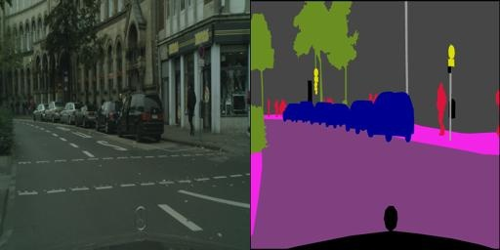
Dataset Description-
Cityscape Image Pairs
This dataset is taken from Kaggle and mainly focuses on semantic understanding of urban street scenes.
Cityscapes Image Pairs dataset is a processed version of the original Cityscapes dataset which contains labelled videos.
The dataset has still images from the original videos, and semantic segmentation labels are shown in images right alongside the original image.
2975 training images files and 500 validation images.
Dimension of each image is: 256x512 pixels.
Link:https://www.kaggle.com/dansbecker/cityscapes-image-pairs

Slide 5
Implementation Details
Classify each pixel of the image into a particular class
CNN used for classification takes an image as input
Series of convolutional and pooling layers
Uses fully-connected layers in the end to output a fixed length vector
The fully-connected layers at the end are replaced by convolutional layers
Output will be with coarse spatial features, which can be further upsampled to form the classification maps corresponding to our image.
Three different methods implemented:
U-Net
Fully Convolutional Network with VGG16 encoder
Fully Convolutional Network with ResNet50 encoder
Notes:
CNNs were designed for image recognition tasks were originally applied to the challenge of handwritten digit recognition¹ ². The basic design goal of CNNs was to create a network where the neurons in the early layer of the network would extract local visual features, and neurons in later layers would combine these features to form higher-order features.

Slide 6
Implementation Details
For preprocessing the dataset and defining the model, we have defined several helper functions –
LoadImage - Loads a single image and its corresponding segmentation map, also allows simple Data Augmentation options such as flipping and rotating
Arguments :
name - Name of the image file
path - Path to the image directory
rotation - Angle by which the image will rotate for Data Augmentation
flip - True/False
size - size of image
Returns - A tuple of 2 numpy arrays (image and segmentation map)

Slide 7
Implementation Details
DataGenerator - creates batches of e.g. 10 raw-segmented image pairs at a time, also uses image augmentation and randomly flips and rotates the images to increase the effective size of the dataset and returns data in form of batches
Arguments :
path - location or path of the image directory
batch_size - size of each batch
maxangle - angle to rotate image
Returns - Tuple of batch_size number of images and segmentation maps

Slide 8
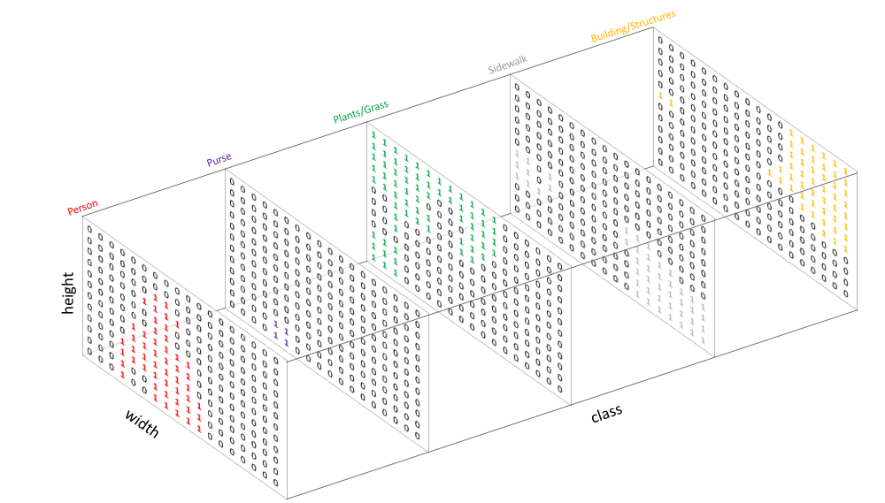
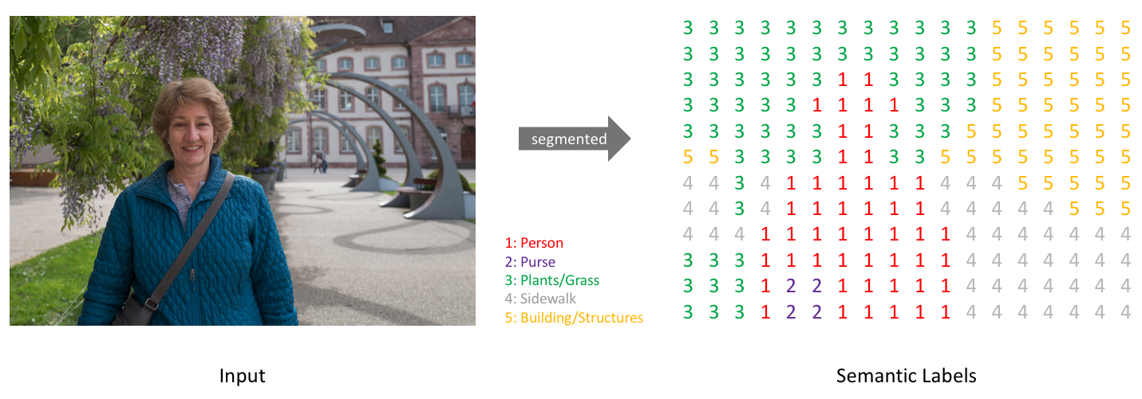
Implementation Details
To find the most important colors and identify similar colors we can use K-Means clustering. This also allows us to go from a color representation to a class representation
ColorToClass - Converts the discrete color representation (output of the color clustering) to a 13-dimensional class representation used for training our model
Arguments :
seg - Segmentation mask after clustering (width, height, 3) (RGB)
Returns - Categorical segmentation map (width, height, classes)

Slide 9
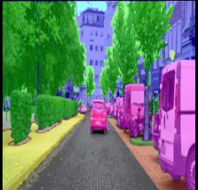
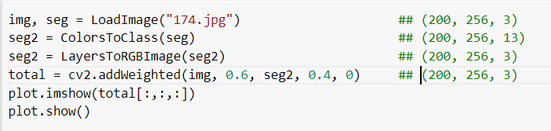
Implementation Details
LayersToRGBImage - Converts the layer representation (categorical arrays) to a color representation for visualization
Arguments :
img - Categorical segmented map (height, width, 13)
Returns - Colored segmentation map (width, height, 3) (RGB)

Slide 10
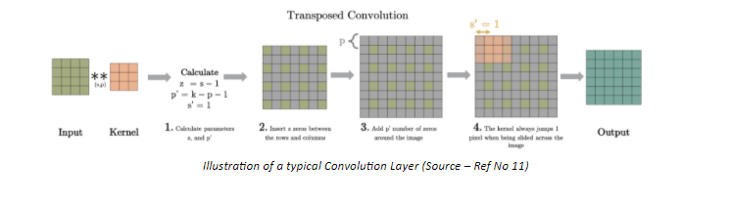
Implementation Details
Transposed Convolution
Transposed Convolution or like some people incorrectly call it Deconvolution, can be seen as an opposite action to Convolution.
Unlike convolution, a transposed convolution layer is used to upsample the reduced resolution feature back to its original resolution.
A set of stride and padding values is learned to obtain the final output from the lower resolution features. The below illustration explains the procedure in a very easy to understand manner.

Slide 11
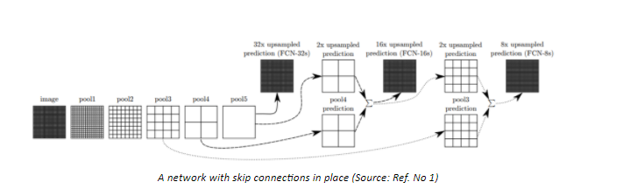
Implementation Details
Skip Connections
Downsampling reduces the resolution of the input by a large factor, thus during upsampling it becomes very difficult to reproduce the finer details even after using sophisticated techniques like Transpose Convolution.
Obtain a coarse output .
Adding ‘skip connections’ in the Upsampling stage from earlier layers and summing the two feature maps.
These skip connections provide enough information to later layers to generate accurate segmentation boundaries. This combination of fine and coarse layers leads to local predictions with nearly accurate global (spatial) structure.

Slide 12
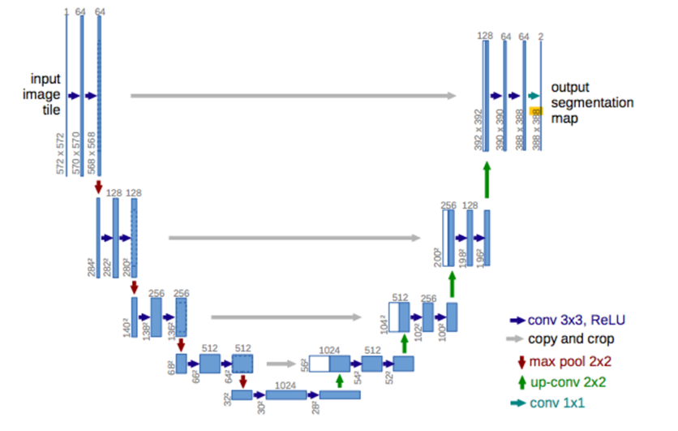
Unet Model
UNet is a special kind of CNN, which uses concatenate layers to feed data from previous layers to the layers close to the output.
The network has a double-funnel shape. The through feeding of data makes sure that no data is lost.
Otherwise the funnel shape would cause something similar to an autoencoder.

Slide 13
Details for training of UNet model
Adam optimizer : adam
Learning Rate : 0.0001
Loss Function : categorical cross-entropy
No. of Epochs : 1000
Steps_per_epoch : 10
Val-Accuracy : 0.7
adam = Adam(lr=0.0001, decay=1e-06)
model.compile(loss='categorical_crossentropy', optimizer=adam, metrics=['accuracy’])

Slide 14
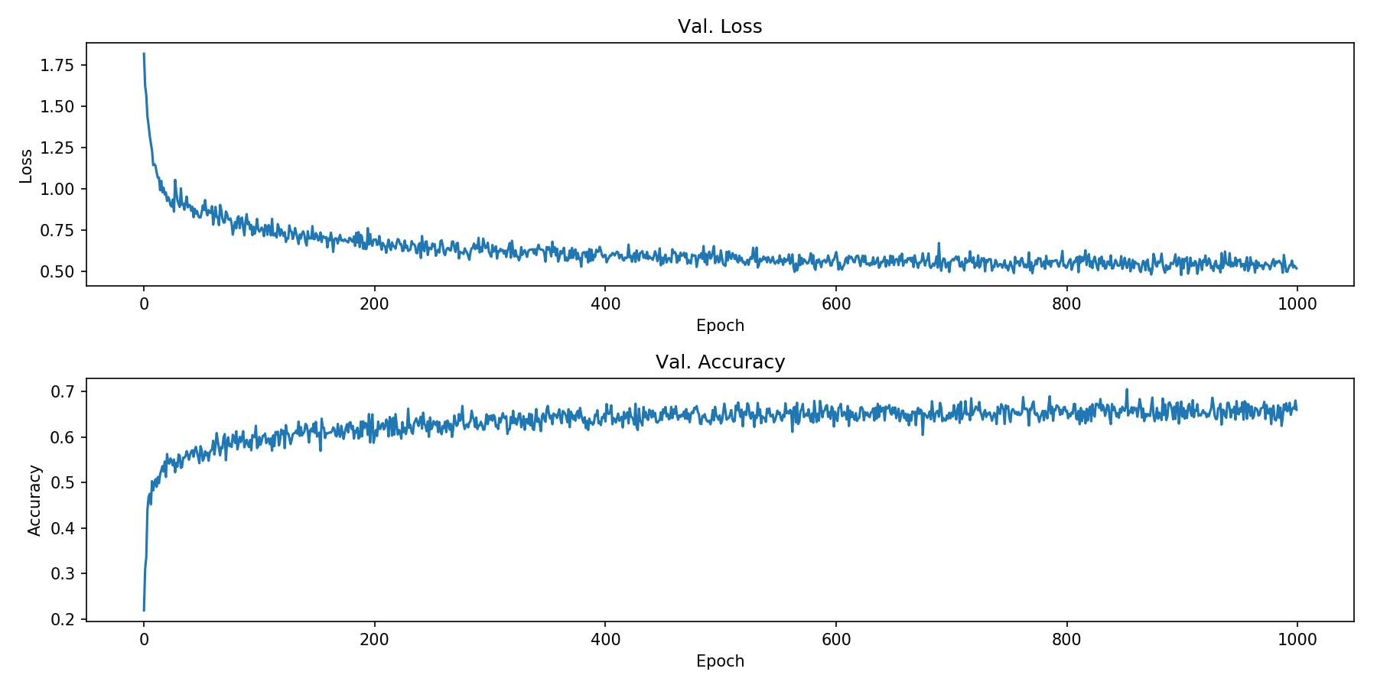
Learning curve for UNet model

Slide 15
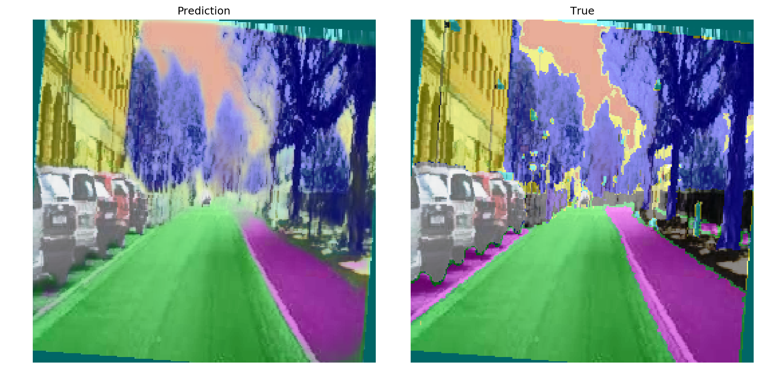
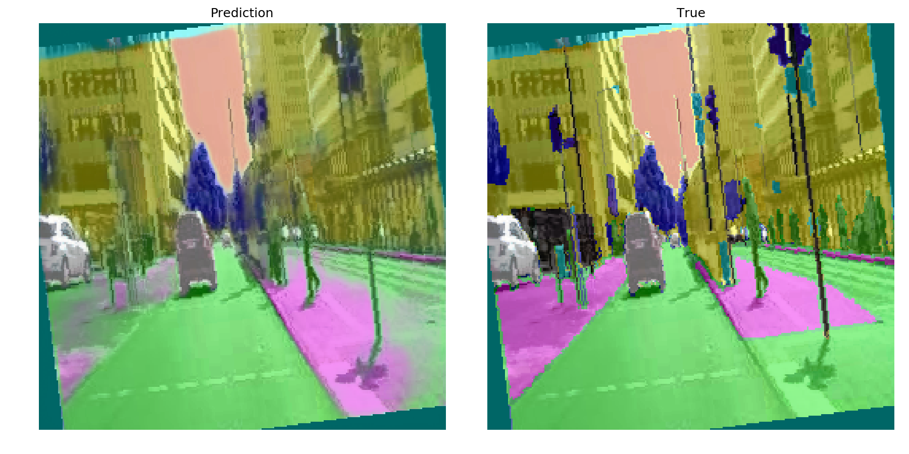
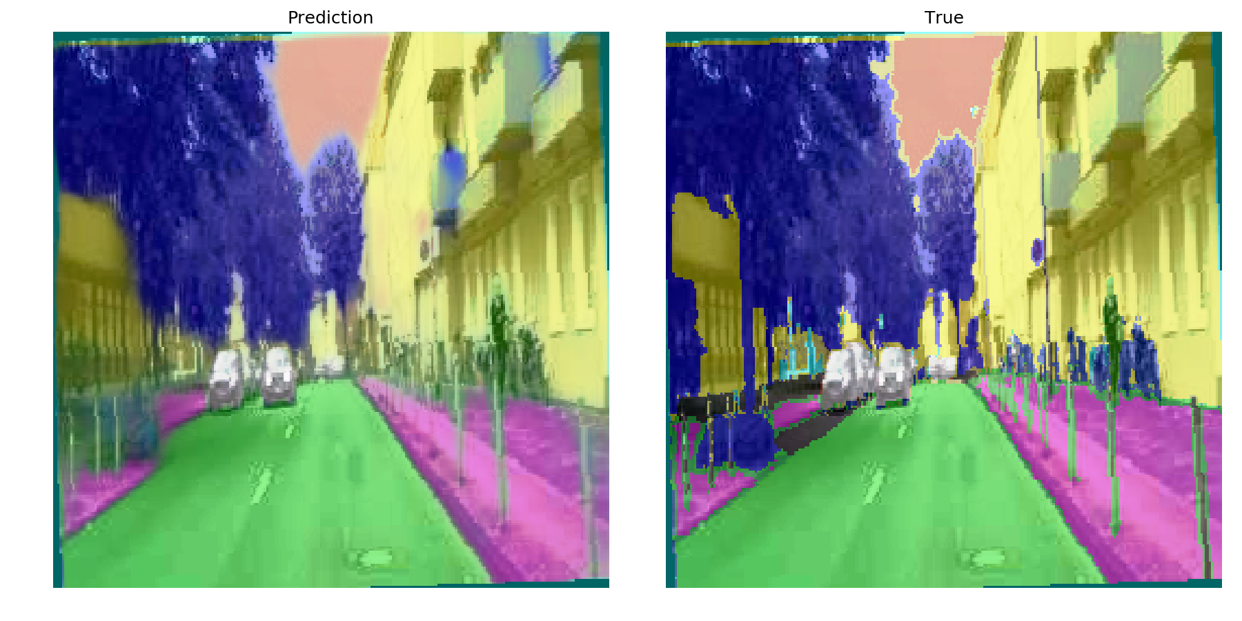
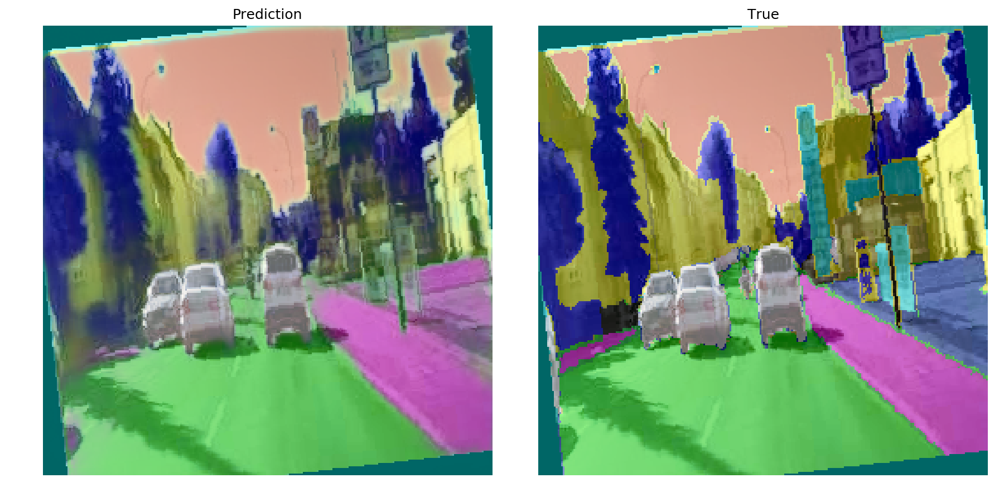
Predicted Results for UNet model

Slide 16
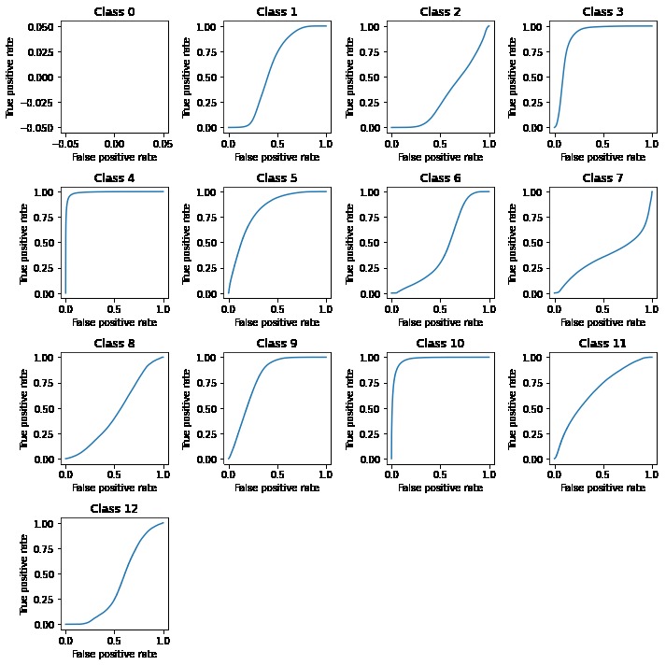
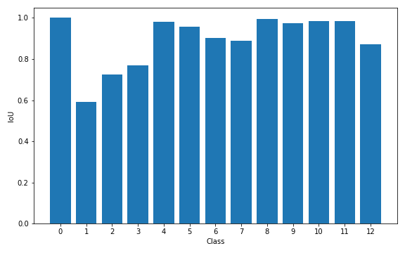
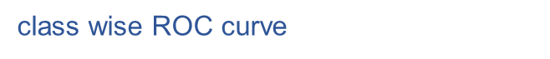
Accuracy Metrics for UNet model

Slide 17

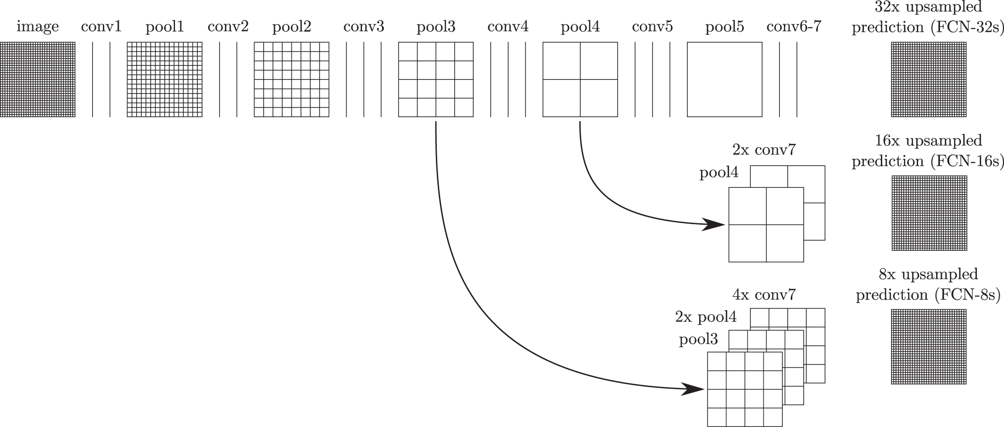
VGG16_FCN Model
Simple architecture
using only 3×3 convolutional layers stacked on top of each other in increasing depth.
Reducing volume size is handled by max pooling.
Two fully-connected layers, each with 4,096 nodes are then followed by a softmax classifier
FCN-8s - Add 1 x 1 convolution on pool3 and fuse it with 2X upsampled fused predictions of conv7 and pool4. The segmentation map is then produced by using a transpose convolution on the result with stride 8

Slide 18
Details for training of VGG16_FCN model
Adam optimizer : adam
Learning Rate : 0.001
Loss Function : categorical cross-entropy
No. of Epochs : 20
Steps_per_epoch : num_of_training_samples/batch_size (297)
Val-Accuracy : 0.8
adam = Adam(lr=0.001, decay=1e-06)
model.compile(loss='categorical_crossentropy', optimizer=adam, metrics=['accuracy’])

Slide 19
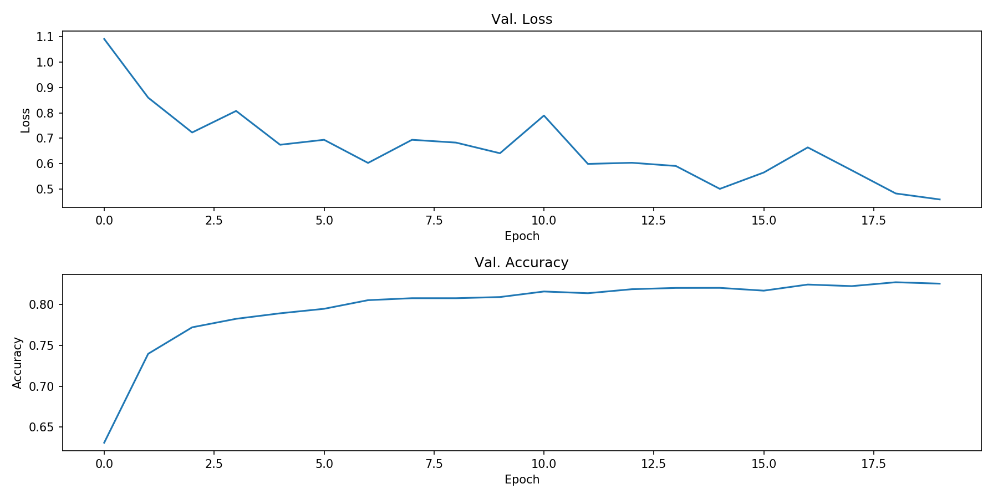
Learning curve for VGG16_FCN model

Slide 20
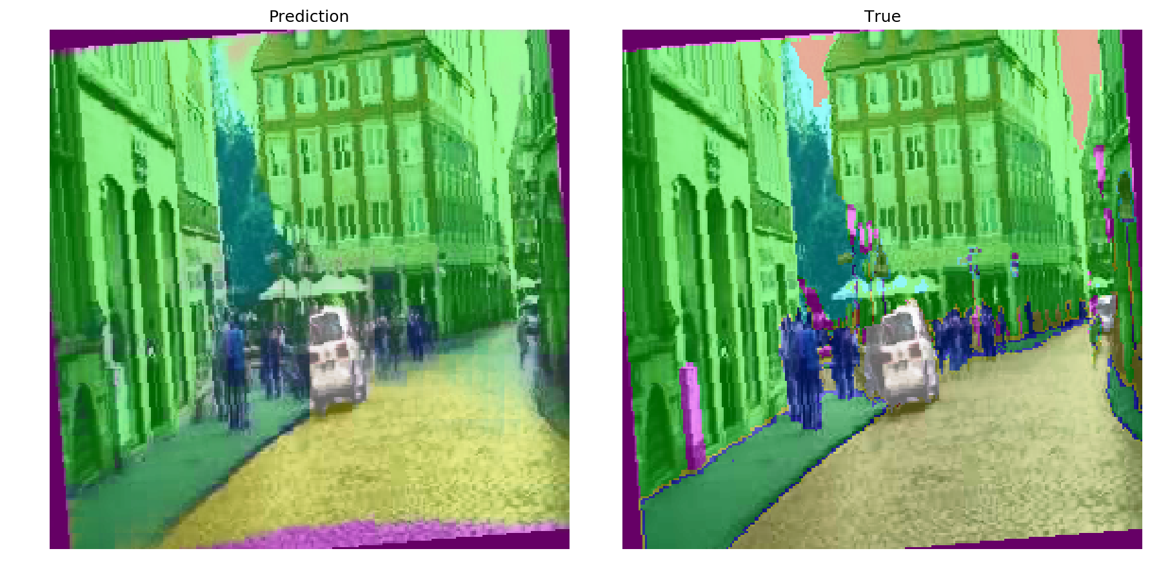
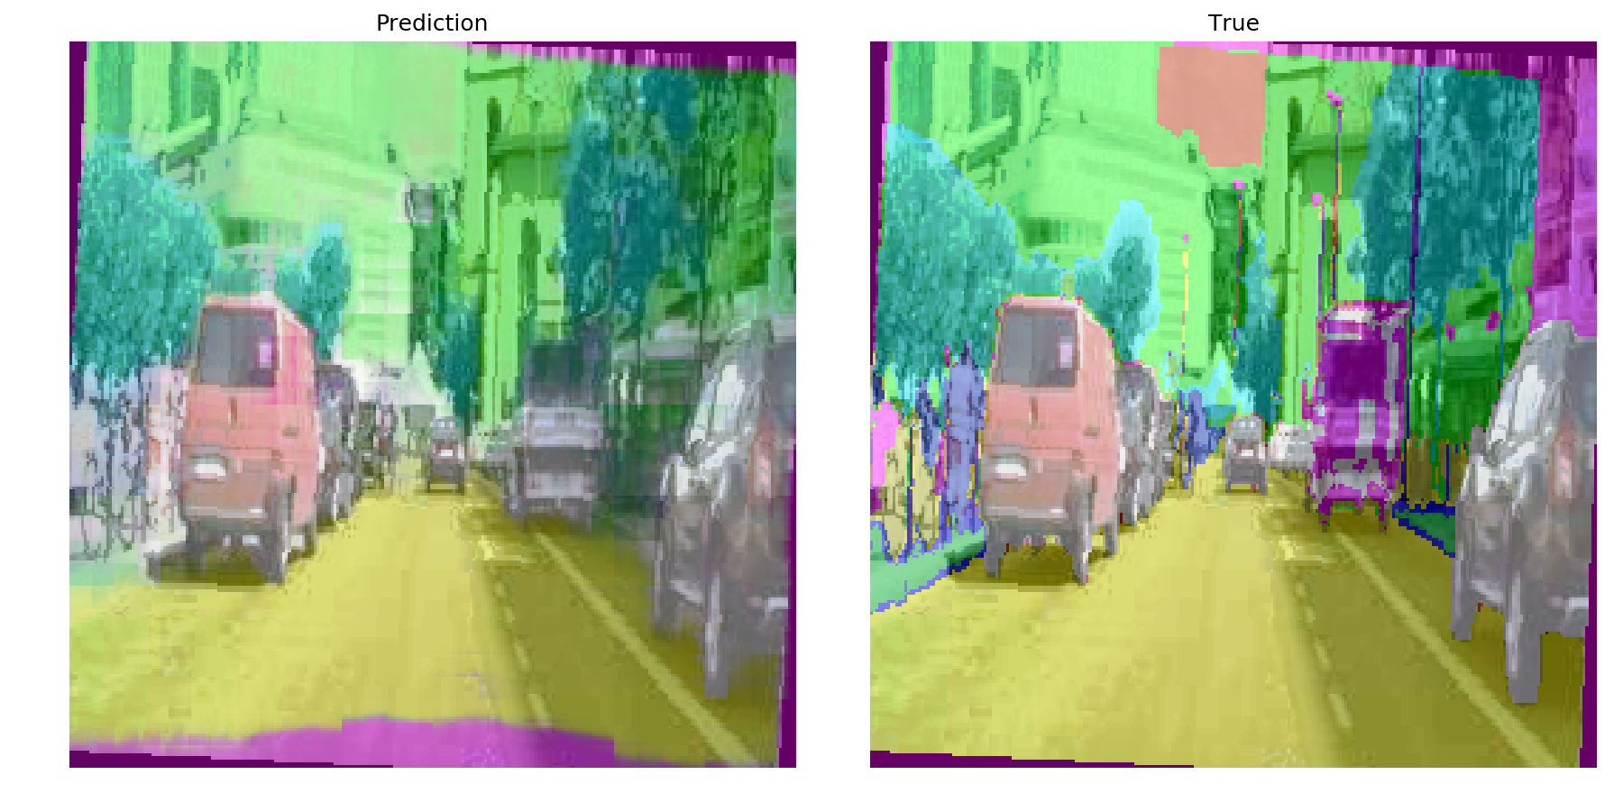
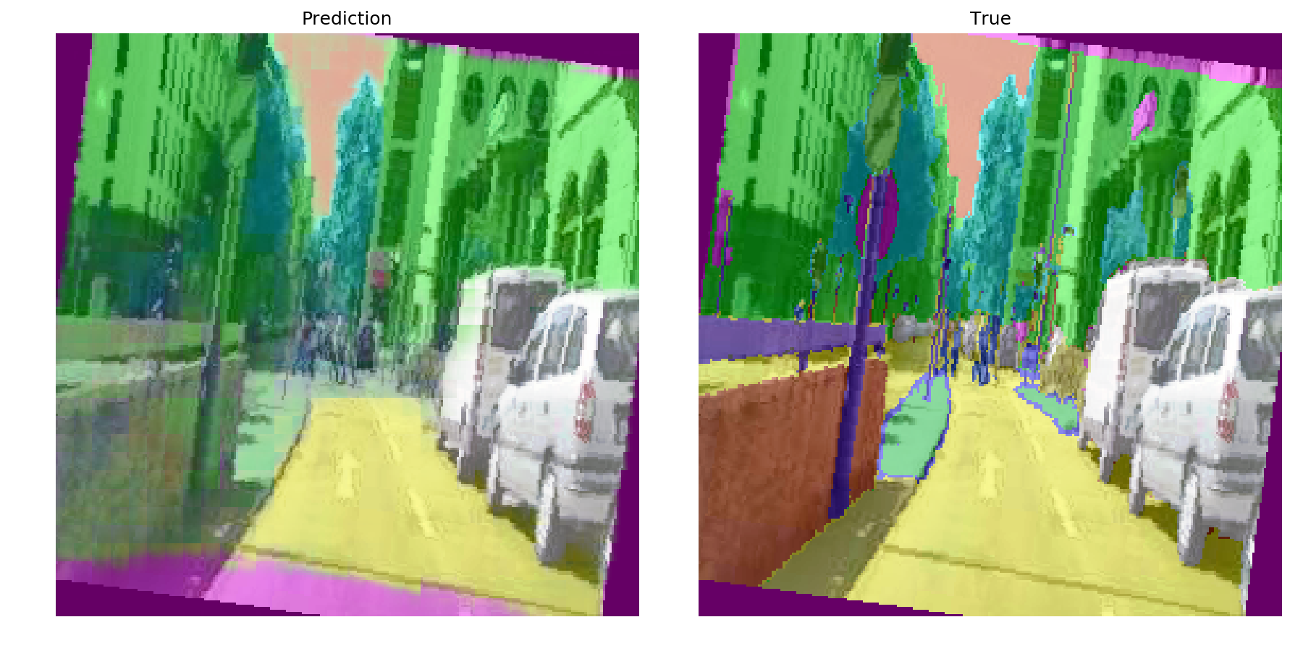
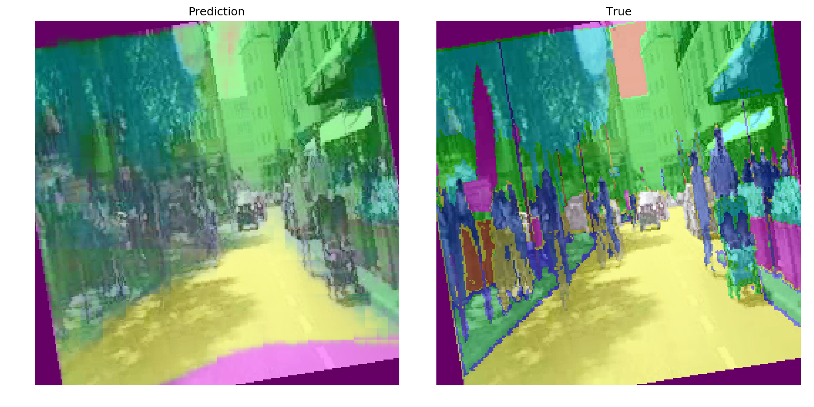
Predicted Results for VGG16_FCN model

Slide 21
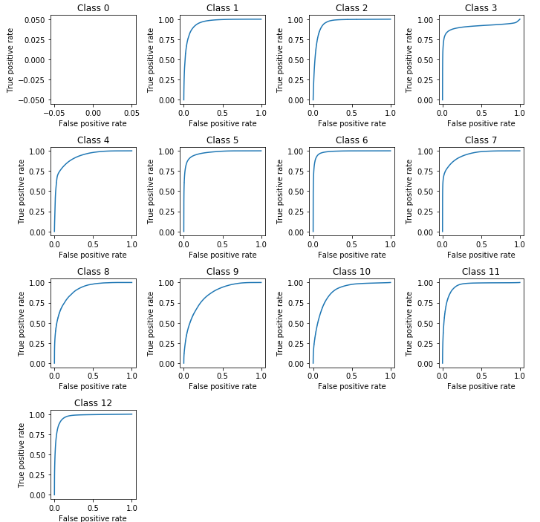
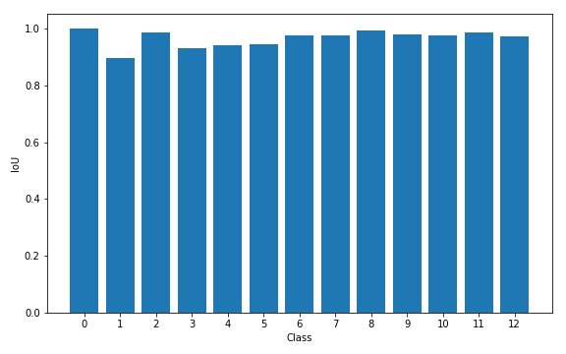
Accuracy Metrics for VGG16_FCN model
class wise ROC curve
class wise Intersection over Union

Slide 22
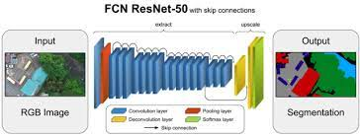
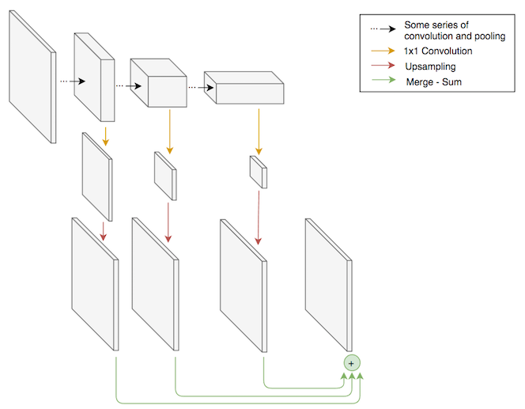
ResNet50_FCN Model
This experiment used a ResNet50-based FCN with connections from the last 32×32, 16×16, and 8×8 layers of the ResNet.
It follows similar architecture as previous model three skip connections followed by up-sampling.

Slide 23
Details for training of ResNet50_FCN model
Adam optimizer : adam
Learning Rate : 0.0001
Loss Function : categorical cross-entropy
No. of Epochs : 20
Steps_per_epoch : num_of_training_samples/batch_size (297)
Val-Accuracy : 0.8
adam = Adam(lr=0.001, decay=1e-06)
model.compile(loss='categorical_crossentropy', optimizer=adam, metrics=['accuracy’])

Slide 24
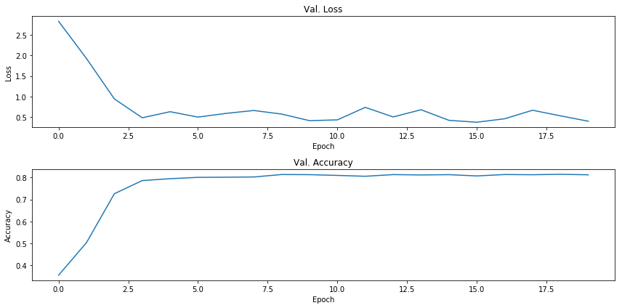
Learning curve for ResNet50_FCN model

Slide 25
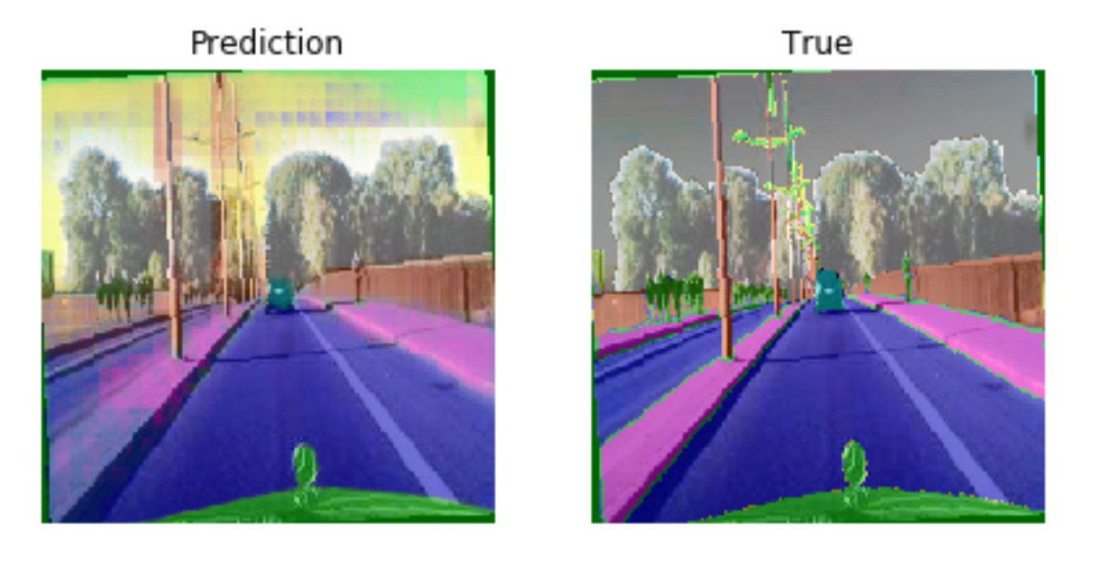
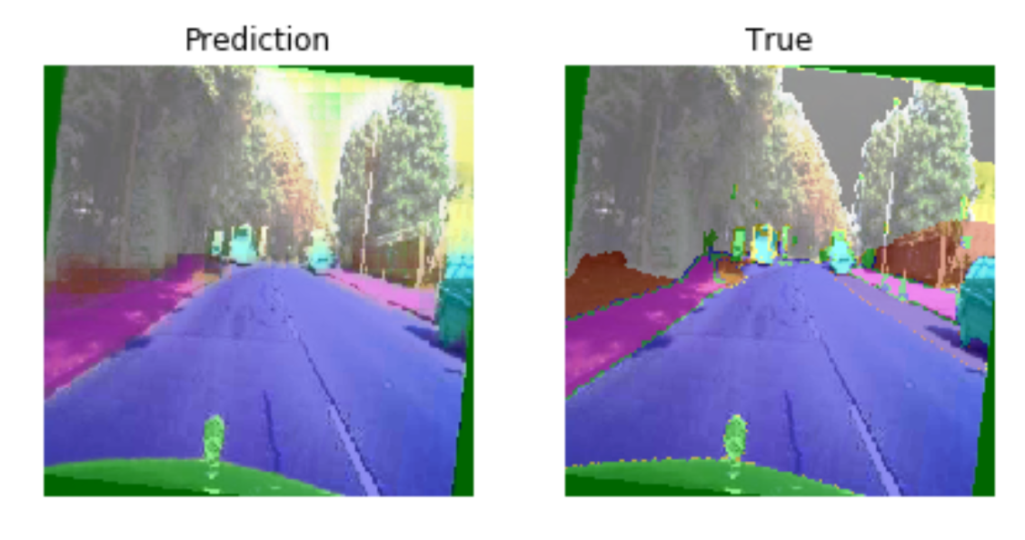
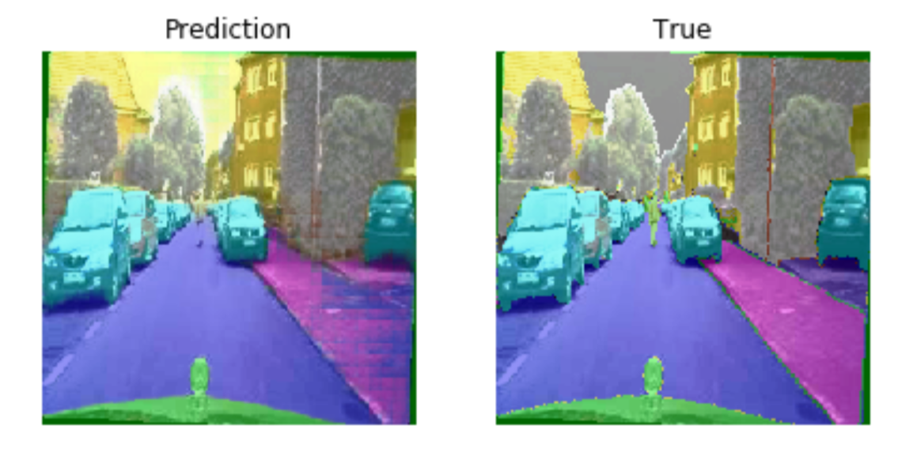
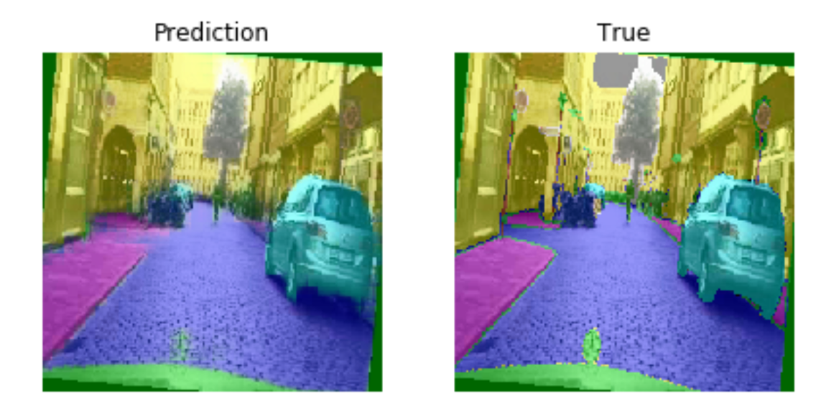
Predicted Results for ResNet50_FCN model

Slide 26
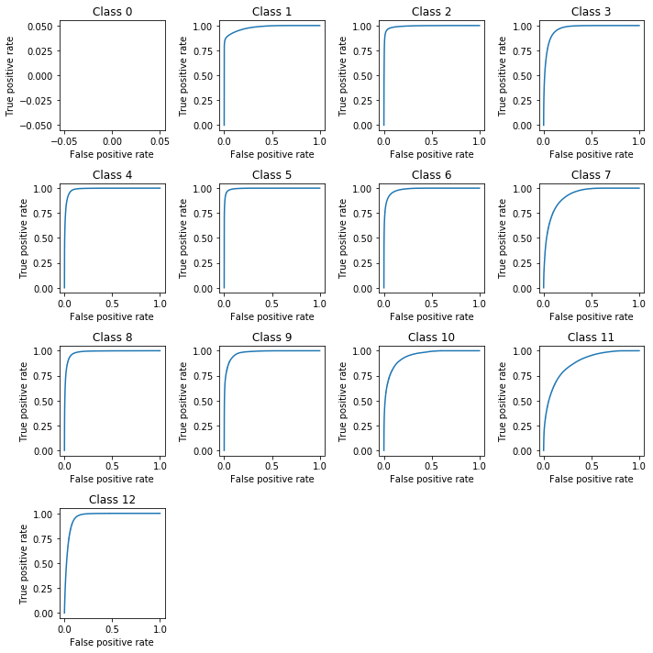
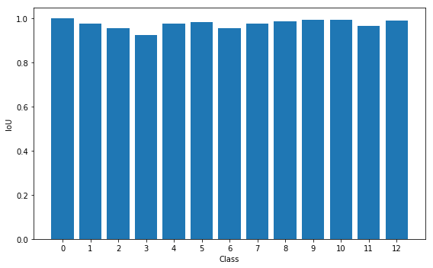
Accuracy Metrics for ResNet50_FCN model

Slide 27
Literature Survey
https://www.cv-foundation.org/openaccess/content_cvpr_2015/papers/Long_Fully_Convolutional_Networks_2015_CVPR_paper.pdf
build “fully convolutional” networks that take input of arbitrary size and produce correspondingly-sized output with efficient inference and learning
Show that convolutional networks by themselves, trained end-to-end, pixels-to-pixels, exceed the state-of-the-art in semantic segmentation
Define skip architecture that combines semantic information from a deep, coarse layer with appearance information from a shallow, fine layer to produce accurate and detailed segmentations
Convolutional networks are a rich class of models, of which modern classification convnets are a special case.
https://ieeexplore.ieee.org/abstract/document/8451495/
Comprised of different network architectures for feature extraction such as VGG16, Resnet18, MobileNet, and ShuffleNet
Experimental results are presented on the Cityscapes dataset for urban scenes

Slide 28
References
https://analyticsindiamag.com/how-neuroscience-is-helping-cnns-perform-better/
https://proceedings.neurips.cc//paper/2020/file/98b17f068d5d9b7668e19fb8ae470841-Paper.pdf
https://divamgupta.com/image-segmentation/2019/06/06/deep-learning-semantic-segmentation-keras.html
https://ieeexplore.ieee.org/document/8354267
https://www.cv-foundation.org/openaccess/content_cvpr_2015/papers/Long_Fully_Convolutional_Networks_2015_CVPR_paper.pdf

